Slide 1
Fertilizer Management System -Aditya Ghodke -Aditya Chougule -Abhijeet Surshetwar

Slide 2
Table Of Content
Table 1 - FARMER
Table 2 – SUPPLY
Table 3 – OFFICER
Table 4 – CULTIVATION
Table 5 – FERTILIZER
Table 6 – RECEIVER
Table 7 - STORES

Slide 3
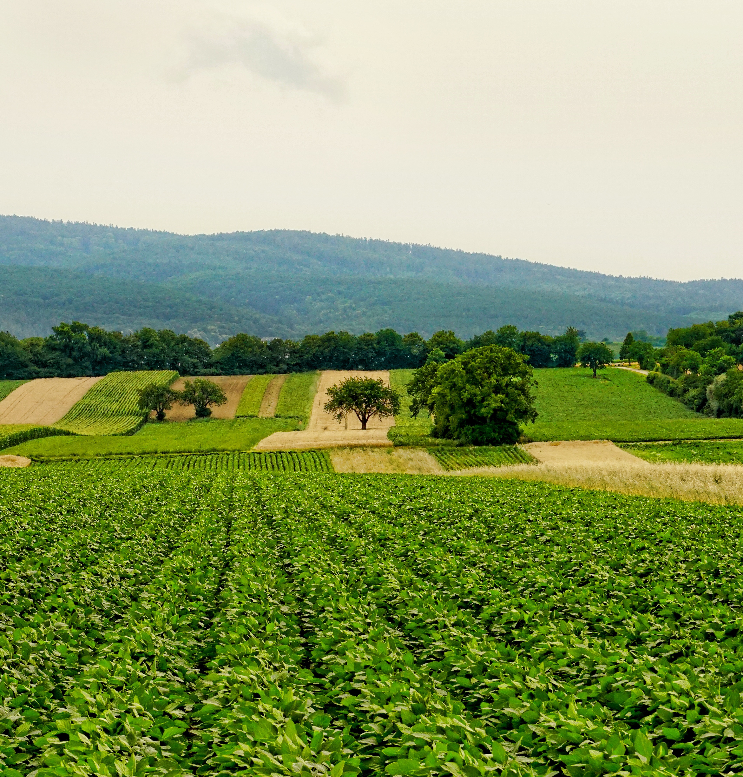
Farmer Table
CREATE TABLE FARMER(
FarmerID CHAR(4) NOT NULL,
FName VARCHAR(20) NOT NULL, LName VARCHAR(20) NOT NULL, Address VARCHAR(200) NOT NULL, TelNo CHAR(10) NOT NULL,
NIC VARCHAR(12) NOT NULL);

Slide 4
Officer Table
CREATE TABLE AGRICULTURAL_OFFICER( OfficerID CHAR(4) NOT NULL, CenterID CHAR(4) NOT NULL, FName VARCHAR(20) NOT NULL, LName VARCHAR(20) NOT NULL, TelNo CHAR(10) NOT NULL);

Slide 5
Supply Table
CREATE TABLE SUPPLY (
CenterID CHAR(4) NOT NULL, Division VARCHAR(30) NOT NULL, PRIMARY KEY(CenterID));

Slide 6
Cultivation Table
CREATE TABLE CULTIVATION(
LandID CHAR(4) NOT NULL, FarmerID CHAR(4) NOT NULL, OfficerID CHAR(4) NOT NULL, CropName VARCHAR(30) NOT NULL,
LandArea DECIMAL(8,3) NOT NULL, Month VARCHAR(20) NOT NULL, PRIMARY KEY(LandID),
FOREIGN KEY (FarmerID) REFERENCES FARMER(FarmerID));

Slide 7
Fertilizer Table
CREATE TABLE FERTILIZER(
FertilizerID CHAR(4) NOT NULL, Description VARCHAR(30) NOT NULL,
PRIMARY KEY(FertilizerID));

Slide 8
receiver Table
CREATE TABLE RECEIVES(
LandID CHAR(4) NOT NULL, FertilizerID CHAR(4) NOT NULL,
IssueDate DATE,
Amount DECIMAL(8,3) NOT NULL,
FOREIGN KEY (LandID) REFERENCES CULTIVATION(LandID));

Slide 9
Stores Table
CREATE TABLE STORES(
FertilizerID CHAR(4) NOT NULL,
CenterID CHAR(4) NOT NULL,
QtyOnHand DECIMAL(8,3) NOT NULL,
StoredDate DATE,
ExpireDate DATE,
FOREIGN KEY (FertilizerID) REFERENCES FERTILIZER(FertilizerID),
FOREIGN KEY (CenterID)
REFERENCES SUPPLY(CenterID));

Slide 10
Some Important info about tables
Techniques for connecting
The Primary key one table will be the foreign key of another table to establish the connection between tables.
There are more than one foreign key present inside the table.

Slide 11
Final tips & takeaways
Key Tables and Attributes
Database Relations
Farmer
Farmerid(Primary Key)
Fname
Lname
Fertilizers
FertilizerID(Primary key)
Name
Type
Farmer and Fields
Officer and cultivation
Stores and farmer

Slide 12

THANK YOU

